Slide 1
Markets
Module 1 – Video 2
Management 405
Prof. Nico Voigtländer · UCLA Anderson
Notes:
Video 2 is about markets: what a market is, and how you decide where its boundaries lie.

Slide 2
Module 1 · Video 2 · Markets
Outline of Module 1
1
Markets
Video 2: what a market is, and how far it extends
2
Demand and supply
3
Equilibrium
4
Economic costs include opportunity costs
5
Ignore sunk costs
6
Use cost-benefit and marginal analysis
Management 405 · Module 1 · Basic Concepts and Economic Principles
2
Notes:
Markets is the topic of this video. The question sounds simple and is not: which products, and which places, belong in the same market as yours?

Slide 3
Module 1 · Video 2 · Markets
Market Definition
A company must understand its market
Customers
Competitors (actual and potential)
Extent of market
Which products belong to a market?
Simple test to identify the range of products in your market: If the price of another product changes, will demand for your product change?
Relevant for antitrust litigation (in mergers & acquisitions)
Geographic boundaries
Coffee shop in Venice (CA) vs. gasoline retail vs. App purchases
Management 405 · Module 1 · Basic Concepts and Economic Principles
3
Notes:
A company has to know three things about its market: who its customers are, who its competitors are, both actual and potential, and how far the market extends. The practical test for the product boundary is whether a price change elsewhere moves demand for your product. The geographic boundary varies enormously: a coffee shop in Venice competes with the next street, gasoline retail with the next few miles, gold with the whole world.

Slide 4
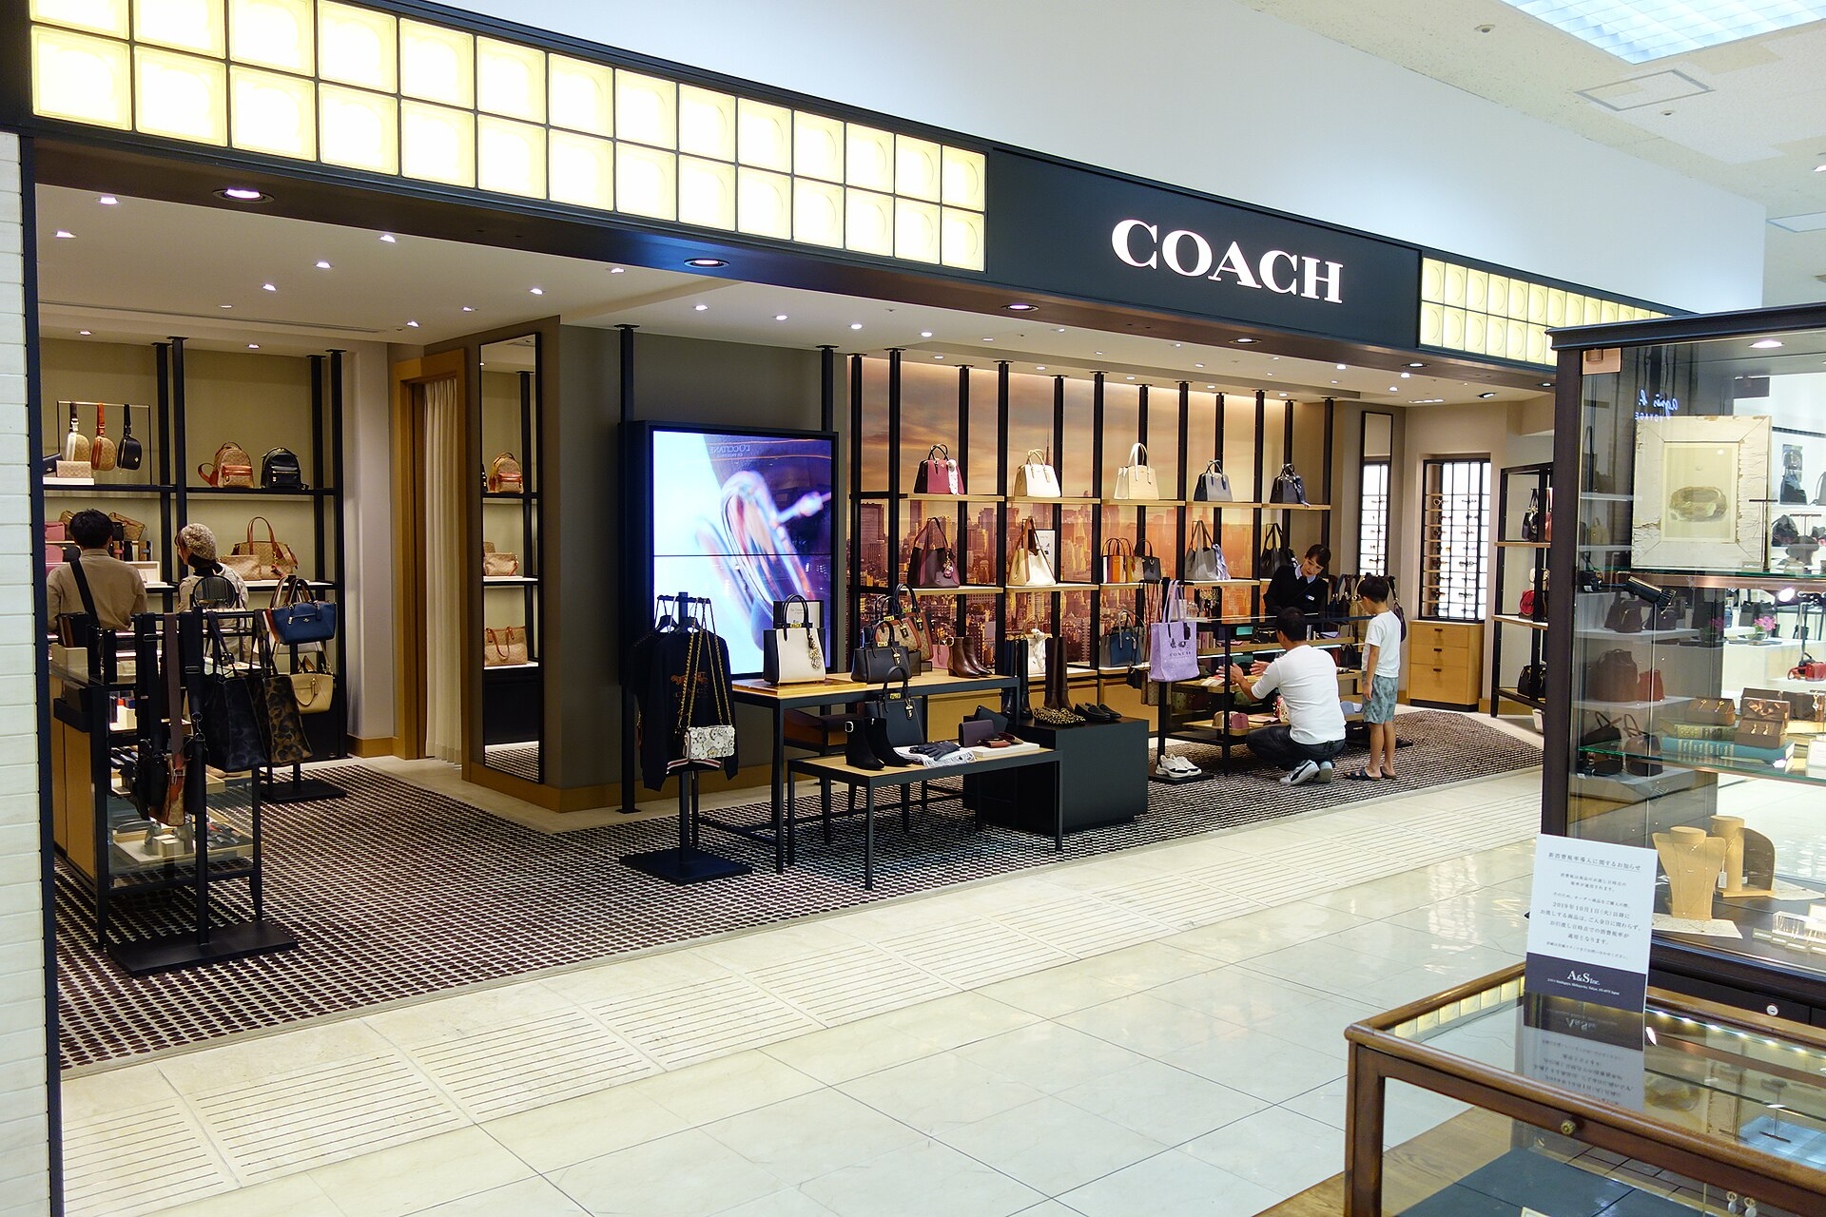
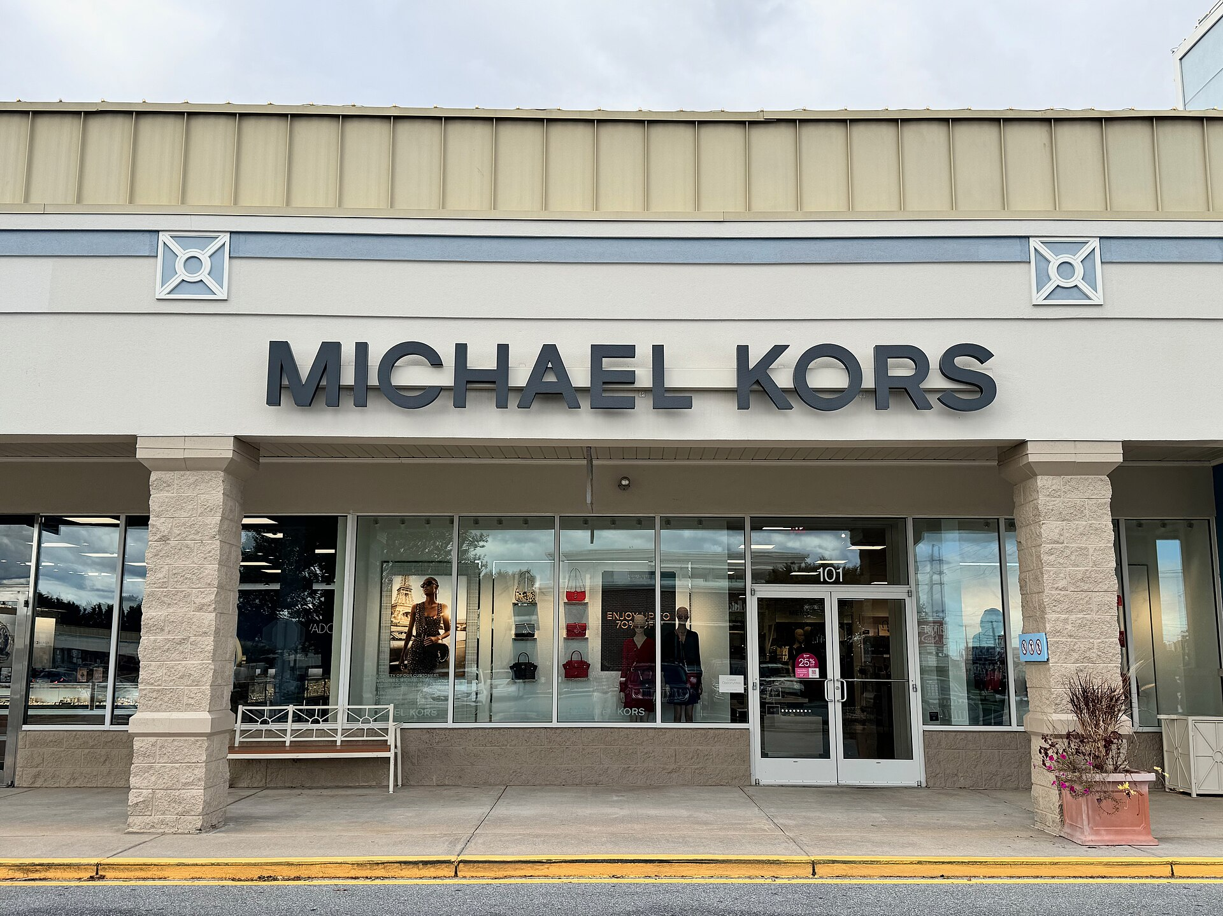
Module 1 · Candidates · Market Definition
Market Definition Mini-Case: Tapestry–Capri
Aug 2023: Tapestry (Coach, Kate Spade) agrees to buy Capri (Michael Kors, Versace) for $8.5B
The definition of the market would turn out to be crucial for the case:
FTC: the market is “accessible luxury” handbags — roughly $100 to under $1,000
The firms: the market is all handbags — from fast fashion to Hermès — and entry is easy
Photos: Wikimedia Commons
Management 405 · Module 1 · Example Candidates (for review)
4
Notes:
Expanded from the candidate list (research verified 2026-08-20). Preliminary injunction: Judge Jennifer Rochon, S.D.N.Y., 24 Oct 2024 (169-page opinion); FTC administrative suit filed 22 Apr 2024; merger agreement terminated 13 Nov 2024. The defense called the FTC's market 'gerrymandered'; the court found the 'accessible luxury' segment real — distinct prices, customers, discounting, outlet distribution.
Photos: Wikimedia Commons (Coach store, Tenmaya Fukuyama; Michael Kors store, Rehoboth Beach DE).

Slide 5
Module 1 · Candidates · Market Definition
The Firms' Own Documents Drew the Market Boundary
Mass market under $100
“Accessible luxury” $100 – under $1,000 Coach · Kate Spade · Michael Kors
True luxury $1,000+ · LV · Hermès · Chanel
Combined Tapestry + Capri share of “accessible luxury” handbags:
59% FTC's expert (third-party data)
77% Capri's internal documents
83% Tapestry's internal data
(figures from documents the companies had to hand over in the merger review)
“Bottom line, saying we're in the same market with true luxury is a joke. … Nobody says ‘should I buy a LV bag or a Coach bag?’”
— internal Tapestry message cited by the court
Oct 2024: the court sides with the FTC and blocks the deal — merger abandoned Nov 2024
Management 405 · Module 1 · Example Candidates (for review)
5
Notes:
Share figures (per the Clifford Chance briefing citing the Opinion at 97, verified 2026-08-20): 58.7% per the FTC's economic expert 'from largely third-party data'; 77% calculated in Capri's internal documents; 83% calculated from Tapestry's internal data. Provenance: ordinary-course internal documents that 'come to light during a merger investigation' — compulsory production, not leaks. The term 'accessible luxury' was the firms' own: used extensively in SEC filings and investor presentations before and after the acquisition, 'only for the term to disappear from their lexicon' after the FTC sued (they then preferred 'expressive luxury'). On-slide source line dropped for space — cite: Judge Rochon opinion, S.D.N.Y. (Oct 24, 2024); Clifford Chance & MoFo case notes. Teaching beat (chronological, per Nico 2026-08-20): the previous slide ends on 'market definition would turn out to be crucial'; here reveal the ladder, then the share cards, then the internal quote, and close with the court decision as the punchline.

Slide 6
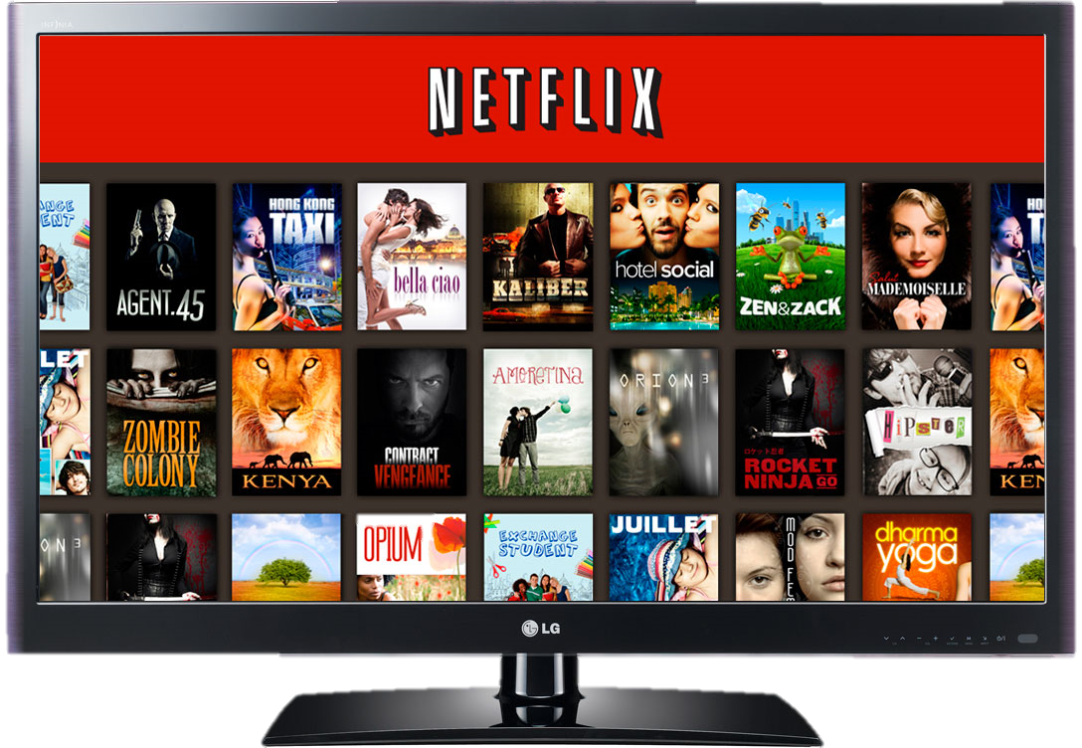
Module 1 · Video 2 · Markets
Market Definition: the Case of Netflix
Define Netflix’s market
Online streaming?
All films?
All entertainment?
Prepare for Class Discussion
Management 405 · Module 1 · Basic Concepts and Economic Principles
6
Notes:
Think about Netflix before class. Is the market online streaming, all films, or all entertainment? And did Covid change the answer, when theatres closed and streaming was the only option? Come with a view, because we will argue about it.

Slide 7
Module 1 · Video 2 · Markets
Actors in the Market
CONSUMERS
WORKERS
FIRMS
Objective: Maximize “utility” from goods and services, given their limited income
Choose a job to earn income
Face trade-offs in their choice of employment
E.g. labor income vs. leisure time / flexibility
Employ workers to produce goods and services for consumers
Objective: Maximize profits (value of the firm)
Management 405 · Module 1 · Basic Concepts and Economic Principles
7
Notes:
Three kinds of actor, each with an objective. Consumers maximize utility from goods and services under a limited income. Workers choose jobs, trading off pay against leisure and flexibility. Firms hire those workers to produce for those consumers, and aim to maximize profit. Almost every model in this course is some combination of these three.

